Slide 1

Factor Analysis of Pitch Design Metrics: Tilt, Release Height, Induced Vertical Break, & Horizontal BREAK
Scott Kobos, Applied Physics
Dr. T. Brian Bunton, Advisor

Slide 2
Study significance
-Lower exit velocity means greater success (less runs on the board) as a pitcher.
-The fewer runs the opposing team scores, the easier it is to win the game.
-Wins matter.

Slide 3
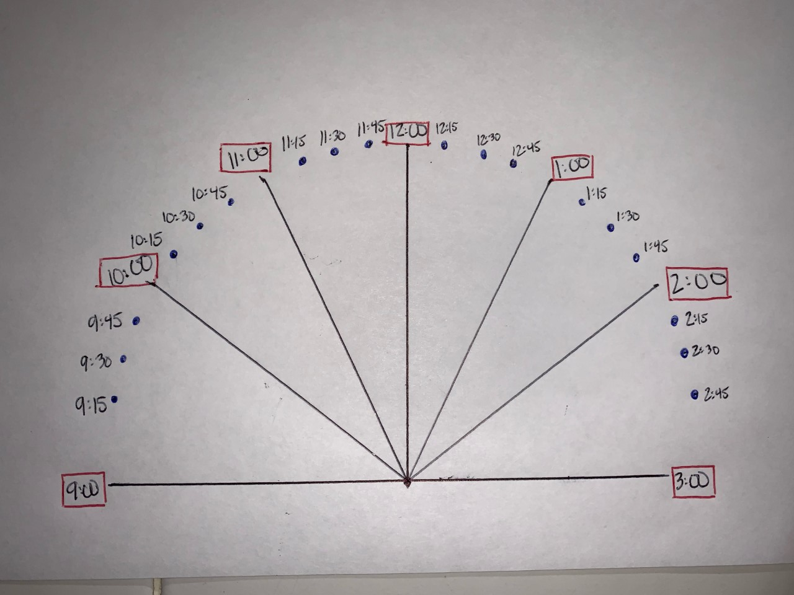

What are the factors?
-Tilt
-Release Height
-Induced Vertical Break
-Horizontal Break

Slide 4

Magnus Force/ Effect
https://giphy.com/gifs/looks-towards-fastball-7PFssIFdPiI0g

Slide 5

Particle Image Velocimetry (PIV)
Barton L. Smith

Slide 6
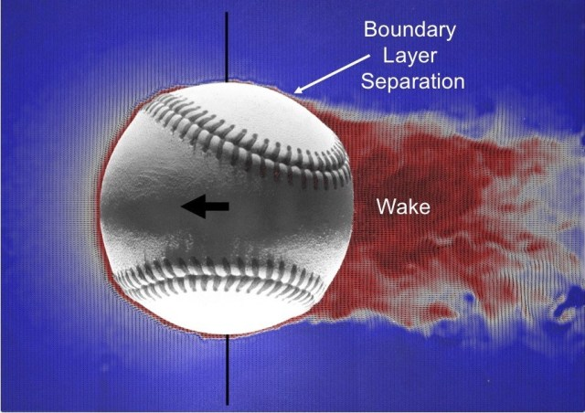
Boundary Layer Separation & Wake
-Size
-Location
-Angle
Barton L. Smith

Slide 7
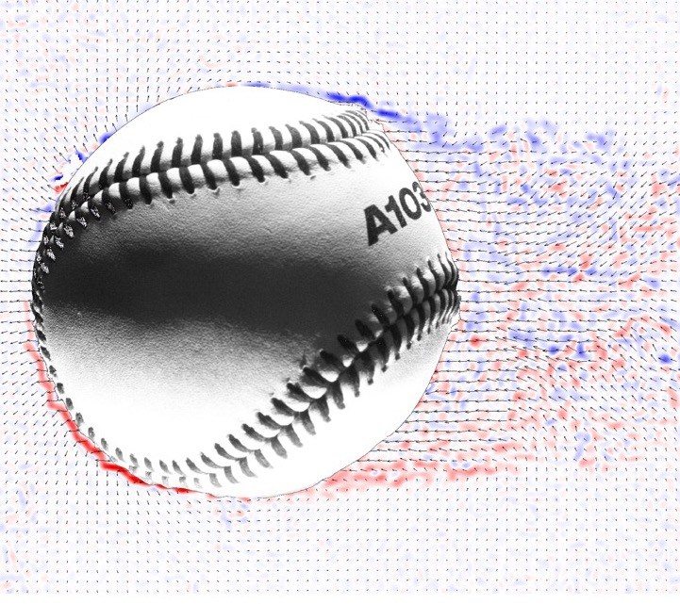

Vorticity
- $ω=∇ x v$
Barton L. Smith

Slide 8
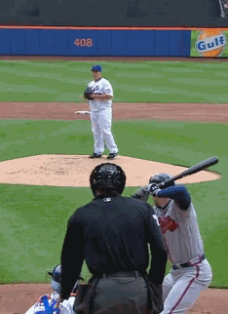
The Laminar Express
http://i.imgur.com/vb9GLRC.gif

Slide 9
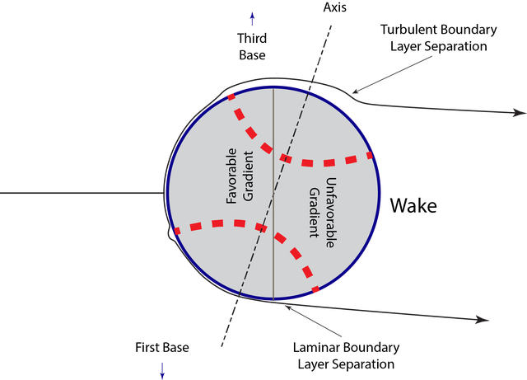

Laminar vs. Turbulent Flow
Barton L. Smith
https://giphy.com/gifs/comments-changeup-strasburg-115RAHRXu4zJzG

Slide 10
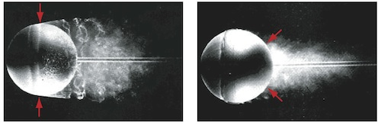
Seams
https://plus.maths.org/content/fly-walks-round-football

Slide 11
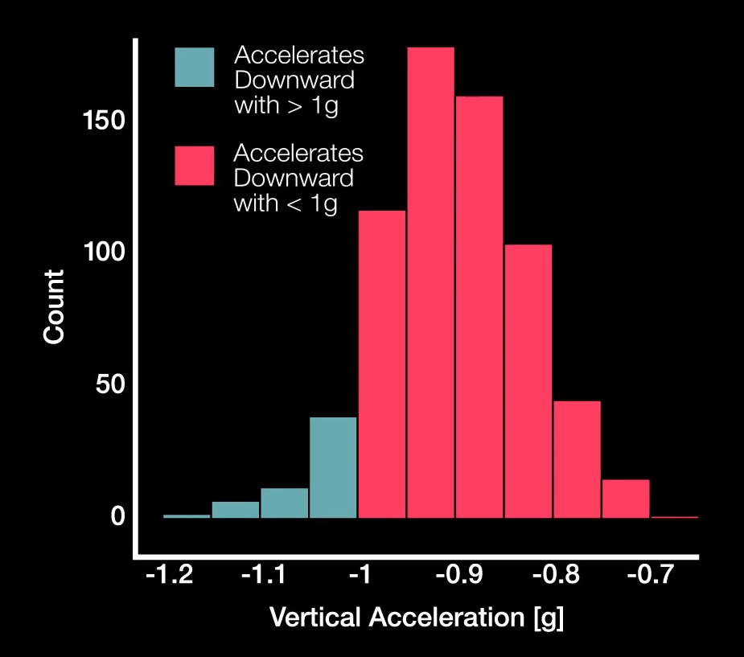
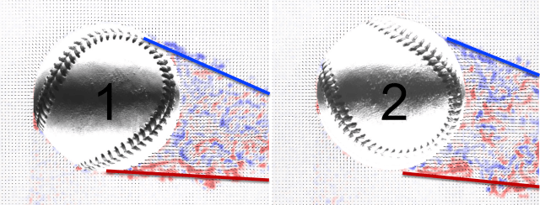
Tilt
Barton L. Smith
-Stephen Strasburg’s changeup accelerates downward with >1g about 10% of the time

Slide 12
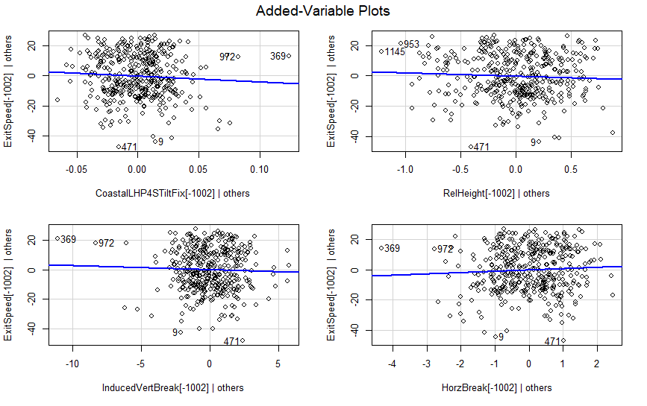
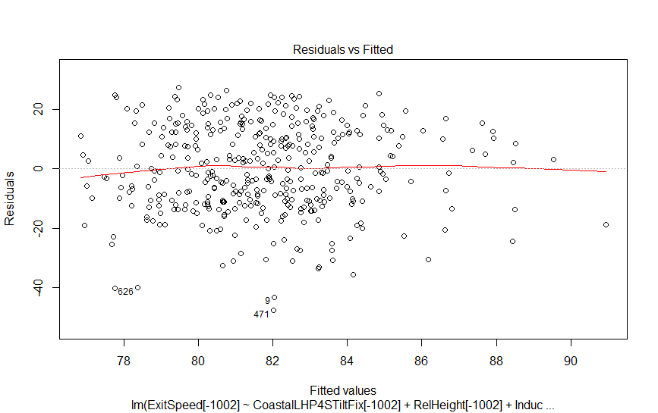
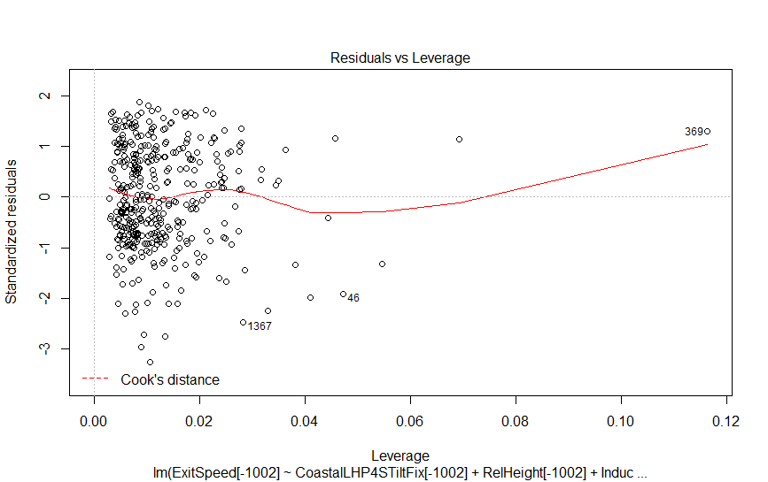
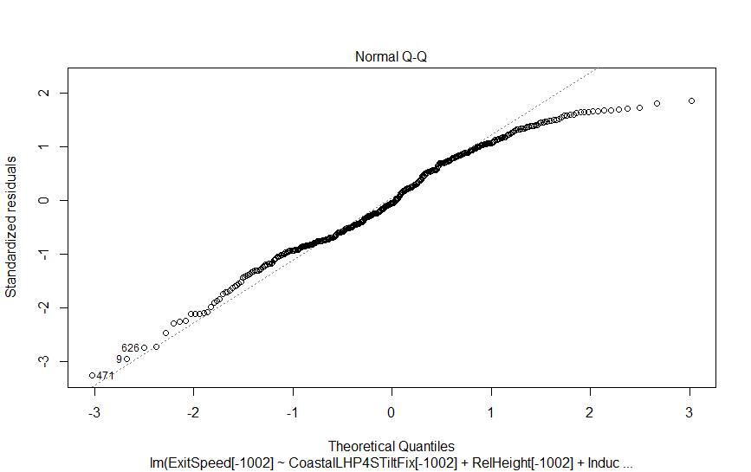
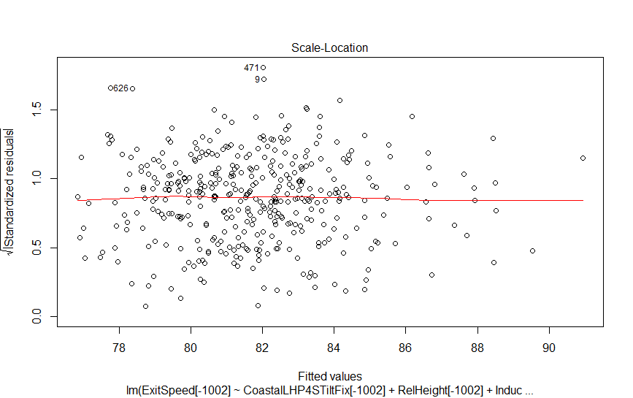
Assumptions (Model Validity)

Slide 13
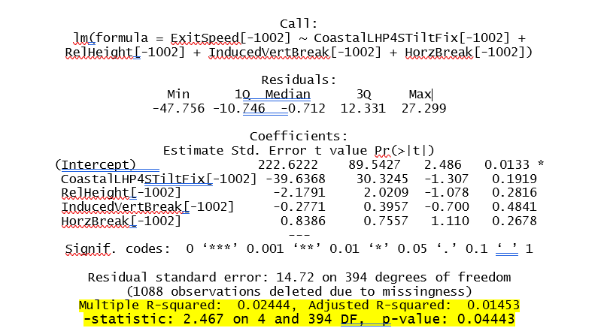
Model Analysis

Slide 14
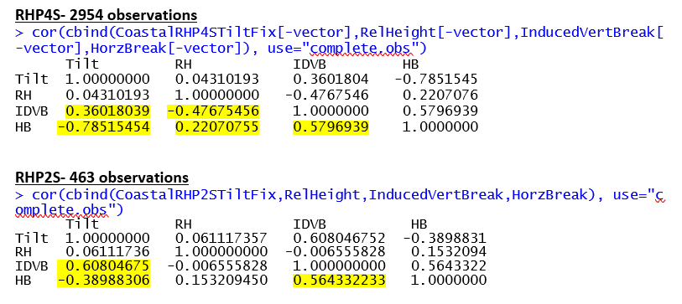
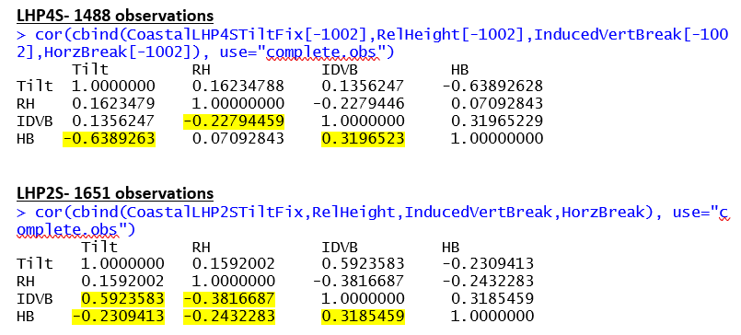
Model Analysis
-Tilt/HB
-Tilt/IDVB
-RH/IDVB
-IDVB/HB

Slide 15
Future Work
-Include a wider range of factors.
-Include swing and miss into analysis.
-Perform similar analysis to Changeups and Breaking Balls (Slider/Curveball).
-Case-by-case analysis.

Slide 16
Conclusion
-Nothing of any statistical significance between exit velocity and any of the factors.
-Analysis found relationships between Tilt and Induced Vertical Break, Release Height and Induced Vertical Break, Induced Vertical Break and Horizontal Break, and confirmed the relationship between Tilt and Horizontal Break

Slide 17
Acknowledgements
-Dr. Lindsay Bell of Coastal Carolina University
-Barton Smith of Utah State University: https://www.baseballaero.com/
-Coastal Carolina University Baseball (Drew Thomas)

Slide 18

Release Height
- The height above home plate at which the pitcher releases the ball, measured in feet.
https://lehmansbaseball.wordpress.com/2016/01/14/custom-vs-one-size-fits-all-throwing-mechanics/

Slide 19
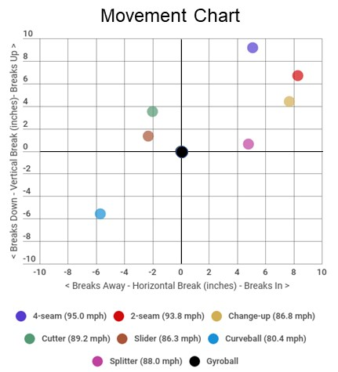
Horizontal & Induced Vertical Break
-The distance between where the pitch crosses the front of home plate versus where the pitch would have crossed home plate if it had traveled in a perfectly straight line from release, measured in inches.
-The distance between where the pitch crosses the plate and where it would have crossed the plate if it would have traveled in a perfectly straight line from release, unaffected by gravity, measured in inches.

Slide 20
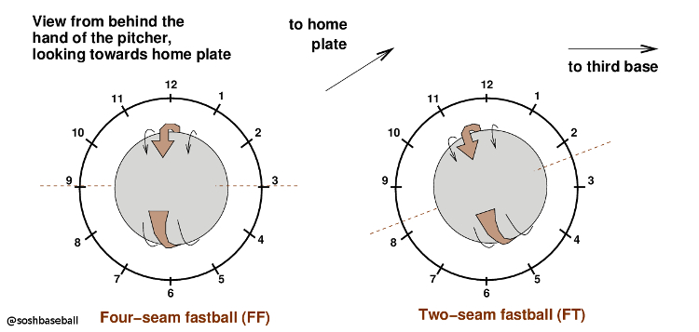
Tilt
-Measured on a clock-like axis and measures the spin direction of a pitch.
-Also called Spin Axis
https://www.drivelinebaseball.com/2019/09/mastering-the-axis-of-rotation-a-thorough-review-of-spin-axis-in-three-dimensions/

Slide 21
Assumptions- Added Variable Plots
-Tests whether each variable adds new information to the model
-Slope of 0 means no information is being contributed by that factor.
-Larger slope means more information that a variable is adding to the model.

Slide 22
Assumptions- Residuals vs. Fitted Plots
-Data must appear random, key is to not observe a funnel shape or any discernable pattern.
-Checks for constant variance, as non-constant variance implies a lack of fit.

Slide 23
Assumptions- Normal Probability Plot
-Produces a straight line if all error is distributed normally; however, with a large enough sample size the line may deviate from linear and still be accepted.

Slide 24
Assumptions- Scale Location Plot
-Residuals are spread equally along the range of predictors and like the normal probability plot, should appear random, with no discernable pattern.

Slide 25
Assumptions- Cook’s Distance Plot
-Identifies leverage points within the data.
-A general rule in interpreting Cook’s distance is that any value with a distance greater than 1 is influential and should be investigated.

Slide 26
Assumptions- Variance Inflation Factor (vif)
vif(LHP4STIHR.mod)CoastalLHP4STiltFix[-1002] RelHeight[-1002] InducedVertBreak[-1002] HorzBreak[-1002]
9.448746 1.157054 2.106317 10.254556
-Shows whether or not some variables can be written as linear combinations of the other variables being tested.
-Any vif under 15 for a variable is considered acceptable.

Slide 27
Image Credits
https://giphy.com/gifs/looks-towards-fastball-7PFssIFdPiI0g
http://i.imgur.com/vb9GLRC.gif
https://plus.maths.org/content/fly-walks-round-football
https://www.drivelinebaseball.com/2019/09/mastering-the-axis-of-rotation-a-thorough-review-of-spin-axis-in-three-dimensions/
https://lehmansbaseball.wordpress.com/2016/01/14/custom-vs-one-size-fits-all-throwing-mechanics/
https://giphy.com/gifs/comments-changeup-strasburg-115RAHRXu4zJzG

